Slide 1
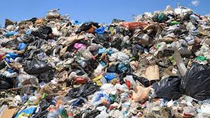
GARBAGE

Slide 2
Garbage
Humans all over the world produce garbage
The average person in the USA produces about 4.6 pounds of garbage per day
Each of you will have produced about 35 Tons* of garbage by the time you’re 50!
About 250 Million tons of garbage will be produced in the USA this year
(*One ton = 2,000 lb)

Slide 3
Where does it all go?
250 Million Tons per Year:
125 million tons will go to landfills
85 million tons will be recycled
40 million tons will be composted

Slide 4
Let’s take a closer look at recycling
To recycle is to use again by converting it into something new.
Metal cans can be melted down and made into new cans.
Plastic bottles can be used to make footwear, travel bags, clothes, road surfaces and many more items.
Glass bottles can be melted down and made into new bottles.
Paper can be re-processed to make new paper products such as kitty litter, paper towels and newspaper.

Slide 5
Green and Blue Trash Bins
LANDFILL RECYCLE

Slide 6
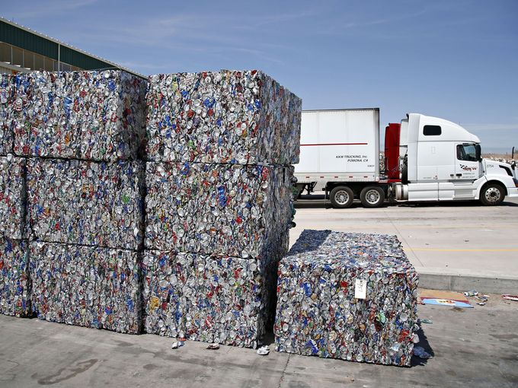
Where do materials to be recycled go?
The blue bins are collected separately from the green bins.
Materials are sorted at a Material Recovery Facility.
Sorted materials are baled ready for delivery to a manufacturer who will re-use them.

Slide 7
So, what do we put in landfills and what do we recycle?

Slide 8
EGG SHELLS
LANDFILL

Slide 9
METAL PIPE
RECYCLE

Slide 10
CARDBOARD BOX
RECYCLE

Slide 11
MAKEUP
LANDFILL

Slide 12
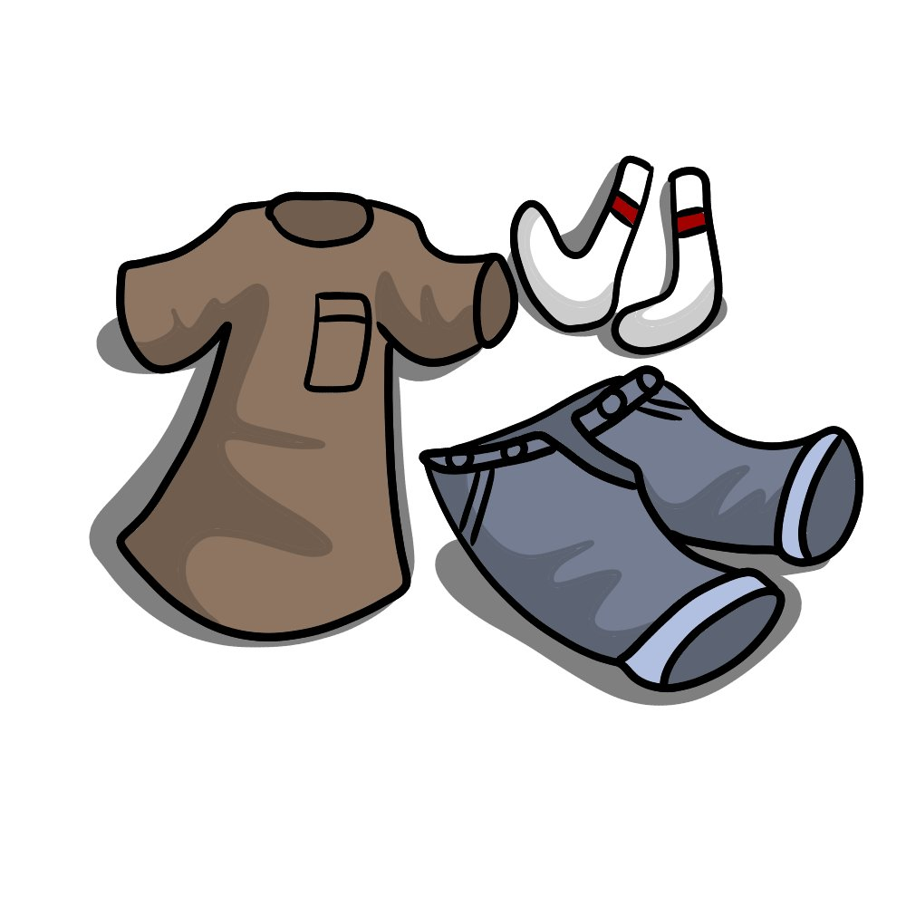
CLOTHES
LANDFILL

Slide 13
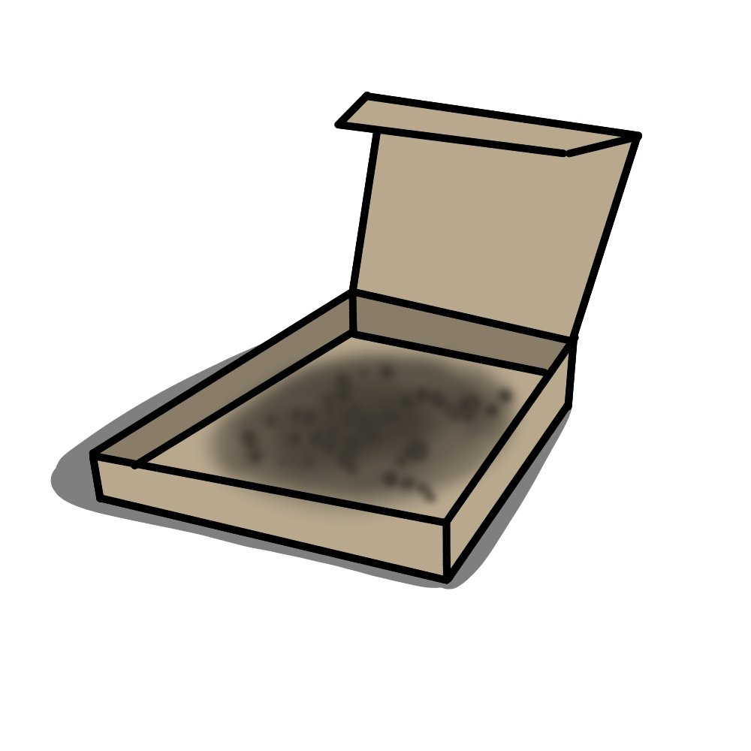
PIZZA BOX (GREASY)
LANDFILL

Slide 14
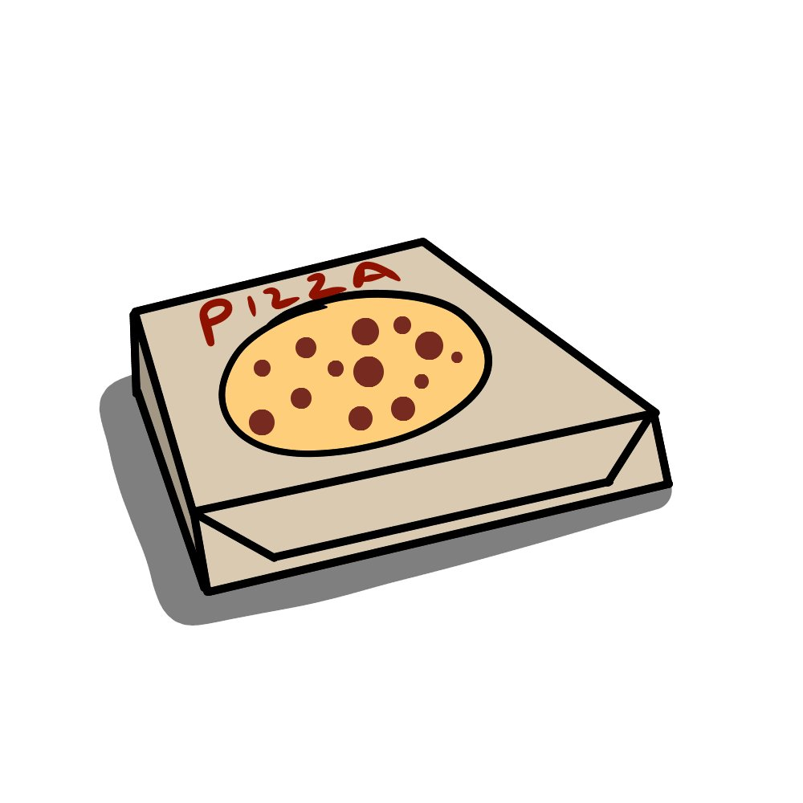
PIZZA BOX (CLEAN)
RECYCLE

Slide 15
PAPER
RECYCLE

Slide 16
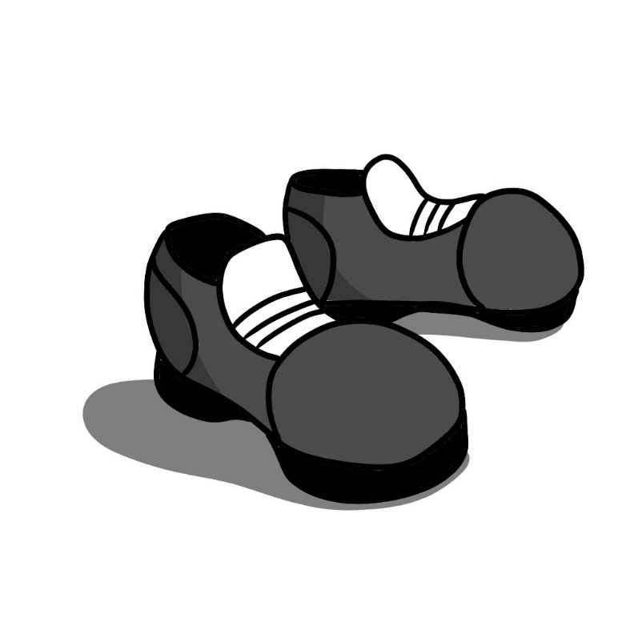
SHOES
LANDFILL

Slide 17
PAPER BAGS
RECYCLE

Slide 18
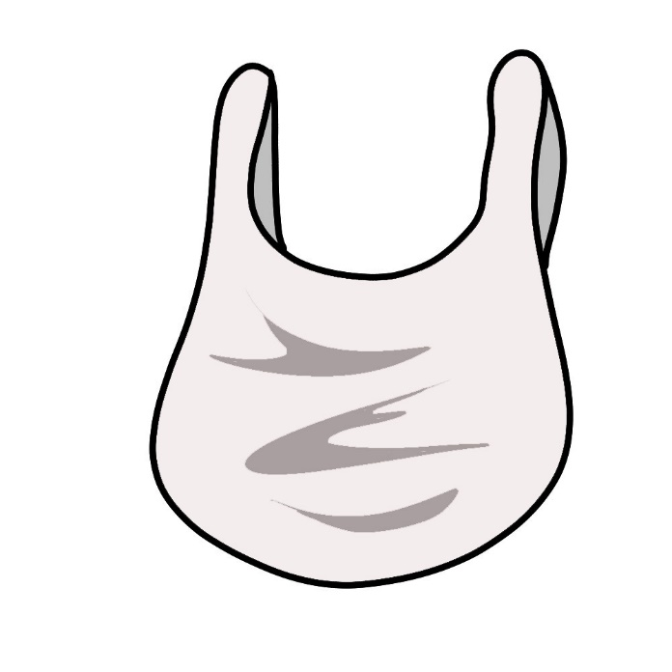
PLASTIC BAGS
LANDFILL

Slide 19
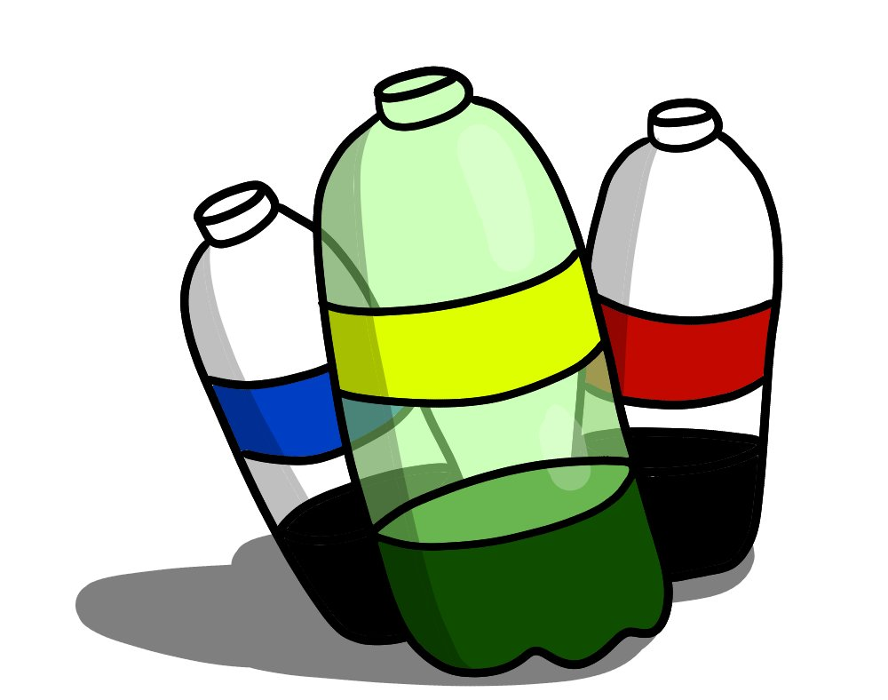
PLASTIC BOTTLES
RECYCLE

Slide 20
CANS
RECYCLE

Slide 21
GRASS CLIPPINGS
LANDFILL

Slide 22
FRUIT
LANDFILL

Slide 23
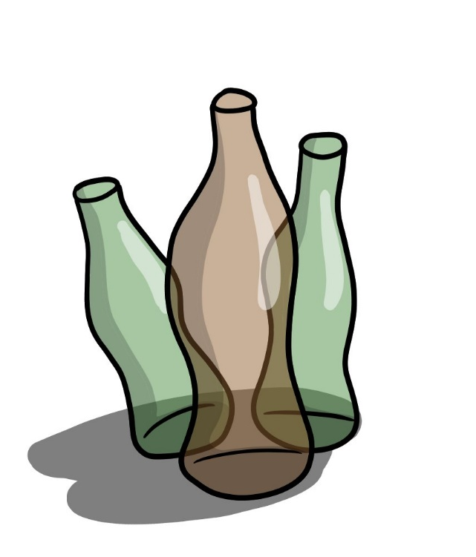
GLASS BOTTLES
RECYCLE

Slide 24
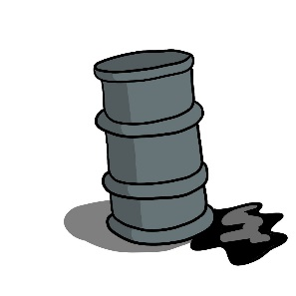
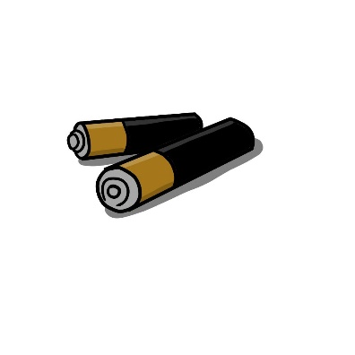
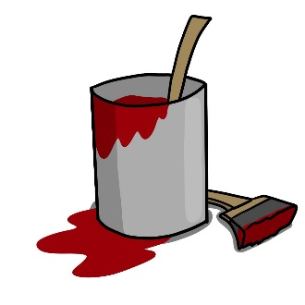
Hazardous Materials (Nasty Stuff)
Used motor oil
Dead Batteries
Electronics
Unused paint
These should be taken to special recycling facilities where they can be disposed of correctly

Slide 25
One More Point
Don’t put recycle items into a bag or a box before putting them in the blue bin – recycle workers do not have the time to look inside and check the contents.

Slide 26
Thank you for participating.

Slide 27
So - What did you think of
our presentation?

Slide 28
GARBAGE!

Slide 29
For More Information:
http://www.garbagemanday.org/history-of-the-garbage-man
http://www.astc.org/exhibitions/rotten/timeline.htm
https://www.glendaleaz.com/sanitation/recycling/funfacts.cfm
https://www.glendaleca.gov/government/departments/public-works/integrated-waste-management/refuse-trash-recycling/recycling-center
https://science.howstuffworks.com/recycled-plastic-waste-creates-roads.htm
https://phoenixaz.recycle.game

